Slide 1
Speech Processing – Term Project Review
24-11-2021 Aparna J Nair-CB.EN.P2CEN20008
Harika Akula-CB.EN.P2CEN20004

Slide 2
HuBERT: Self-Supervised Speech Representation Learning by Masked Prediction of Hidden Units

Slide 3
Objective
The need for high-fidelity representations drove research in self-supervised learning for speech and audio where the targets driving the learning process of a designed pretext task are drawn from the input signal itself
AI system must distinguish and interpret noises that overlap with the speech signal, e.g., laughter, coughing, lip-smacking, background vehicles, or birds chirping.
Self-supervised approaches for speech representation learning are challenged by three unique problems:
There are multiple sound units in each input utterance,
there is no lexicon of input sound units during the pre-training phase,
sound units have variable lengths with no explicit segmentation
HuBERT (Hidden unit BERT) a new approach for learning self-supervised speech representations, to help to model these types of rich lexical and non-lexical information in audio.

Slide 4
Uniqueness
This model learns the structure of spoken input by predicting the proper cluster for masked audio segments using an offline k-means clustering step.
The motivation is the importance of consistency of the k-means mapping from audio inputs into discrete targets

Slide 5
Advantages:
HuBERT model either matches or improves upon the state-of the-art wav2vec 2.0 performance on the Librispeech (960h)
HuBERT shows up to 19% and 13% relative WER reduction on the more challenging dev-other and test-other evaluation subsets.
HuBERT’s simplicity and stability will help natural language processing and speech researchers to more broadly adopt learned discrete representations in their work.
The quality of HuBERT’s learned presentations facilitates easy deployment to many different downstreams speech applications.

Slide 6
Dataset:
LibriSpeech is a corpus of approximately 1000 hours of 16khz read English speech
The audio is in English.
Two configurations – clean and other
Lower WER – clean, higher WER – other
The whole corpus is divided into train, test and validation
Dataset used in this project is test-clean

Slide 7
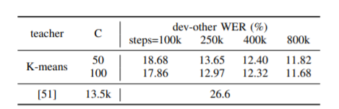
WER with LM:
Model Size
The extra large model pretrained on 16kHz sampled speech audio for 960h.
3.59 GB
# of Parameters
The best model achieves a WER of 11.68%
1 Billion

Slide 8
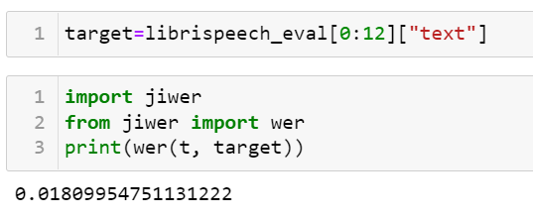
Results:
For test-clean dataset
Taken 12 samples for evaluation
WER – 0.018

Slide 9
Conformer: Convolution-augmented Transformer for Speech Recognition
Objective: The objective is to perform automatic speech recognition using conformer which is a
combination of convolution neural networks and transformer to fetch local and global dependencies respectively of an audio sequence.
Uniqueness: Transformers are good at modeling long-range global context but are less capable to extract fine-grained local features. whereas, convolution neural networks exploit local information baring a limitation of capturing global information.
Conformer containing both these is used for achieving state-of-the art accuracies

Slide 10
Advantages:
Parameter efficient
On the widely used Libri Speech benchmark, the model achieves WER of 2.1%/4.3% without using a language model and 1.9%/3.9% with an external language model on test-clean/test-other
Problem gap:
Ablation study did not show the effect of variation of number of convolution blocks to be used in the conformer encoder and decoder architecture.
Also the effect other forms of attention mechanisms such as efficient attention.

Slide 11
Model Specifications and Results:
Model-size | No. of parameters | WER without LM test-clean test-other
Conformer(S) | 10.3M | 2.7 6.3
Conformer(M) | 30.7M | 2.3 5.0
Conformer(L) | 118.8M | 2.1 4.3

Slide 12
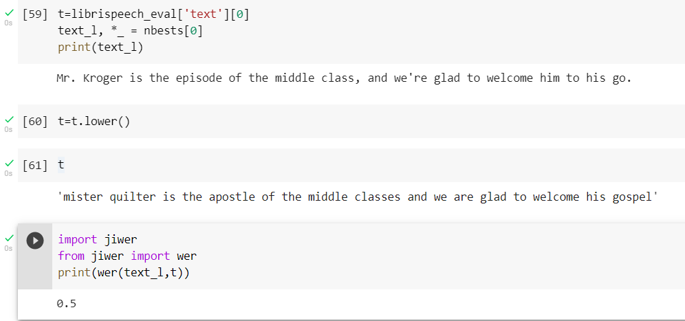
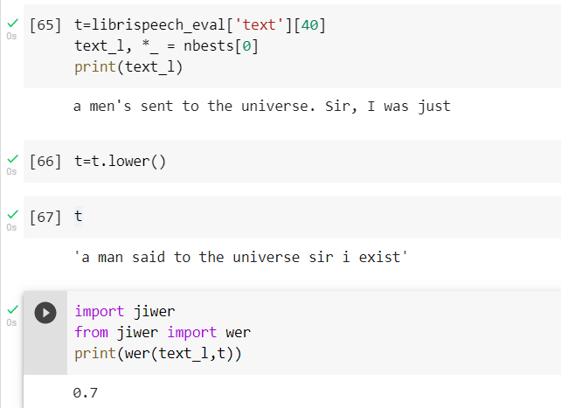
Results:
Taken Dummy dataset containing 73 samples with 16khz sampling rate (because of ram issue)
Taken each sample for evaluating the model
For Sample 0
For Sample 40

Slide 13
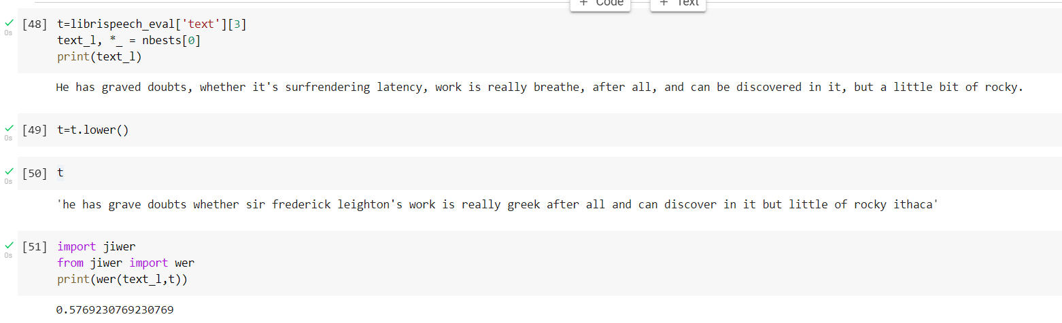
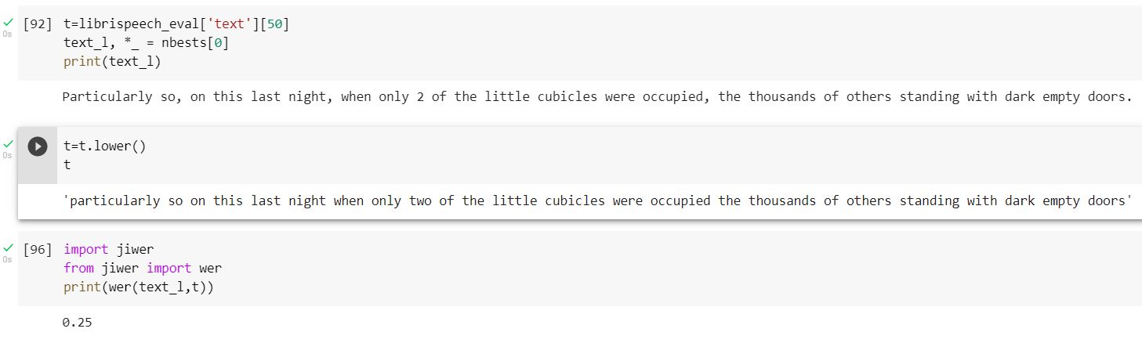
For Sample 3
For Sample 50

Slide 14
THANK YOU

